Slide 1
Prequel for Class 13
Permits and Management
Projects in Progress
Alphabet Soup

Slide 2
Permits are in Place, so we Start to Work!
Major projects always disturb the environment
Often disturb the public
Then the projects encounter the future
But:

Slide 3

The future
There are future events (“states of nature”) that are uncontrollable
Regarding what we can say about these future events, there is a continuum. (“states of nature”)

Slide 4
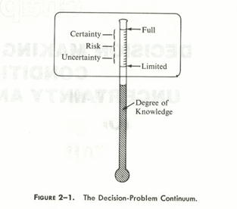

Slide 5
Terms
Certainty
  If we have full knowledge (we believe) of the future. We might approximate that if we have a firm quote from a bonded sub or supplier.
Risk
  Many decisions are made under “risk.” In technical terms, “risk” means we feel we can state the probability of the events. For example, we know the price of concrete in the summer is likely to be $200/CY but may vary by 15%.
Uncertainty
  We recognize alternate states of nature may happen, but we don’t have a clue how likely they are.
  Note the difference between the technical use of terms and the common usage. While the entire future is “uncertain,” if we feel confident we know the probability of the future we say there is “risk” and limit the use of “uncertain” to situations where we do not know the probability of events.

Slide 6
In those terms
Certainties regarding permits, we have dealt with in the planning and permitting stages of the project.
Unknown unknowns I can’t help with. Ask Yoda.
But what follows is a laundry list of the known unknowns – problems that often arise in the course of projects in the environment.

Slide 7
CERCLA
CERCLA is the Superfund law and deals with the liability for contamination by other entities, often a long time ago.
It also deals with the reporting of accidental spills today, as we noted last week.
We broached that last week and noted the value of diligent pre-project inspections

Slide 8
Spills
So spilling any chemical that might be hazardous, whether on land or water, may trigger a report to CERCLA
  Remember long list of chemicals
It will certainly require a report to the local environmental agency – ADEC
Clean-ups will be required and the spill and spill cleanup process will be subject of plans and processes that often require extensive review and that clean-up process may require many permits.

Slide 9
Petroleum Spills
Spills of petroleum and products is often regulated separately.
OPA, Oilspill protection act
  Covers major spills to land or water
  Land – EPA in charge
  Water – Coast Guard in charge with EPA advice

Slide 10
RCRA
RCRA is the “hazardous waste” law.
  Resource conservation and recovery act, “Wreck Rah”
It applies to “generators” of hazardous waste.
  Used oil
  Contaminated fuel
  Left over paint and solvents
  And many other “wastes”

Slide 11
RCRA
Generally need some trained employee
Need a plan for known RCRA waste, such as used oil
Follow the plan

Slide 12
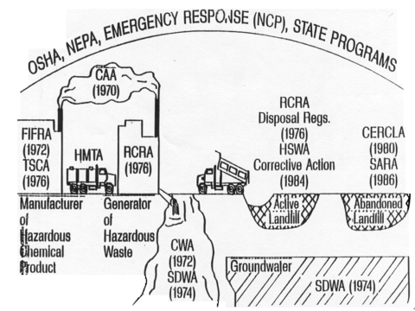
HMTA
Hazardous Material Transportation Act

Slide 13
Transportation of hazardous material is regulated by:
  Federal DOT
  EPA
  OSHA, Occupation Safety and Health Administration
  Local agencies, including fire marshal

Slide 14
Manifesting
Cannot just throw on truck and haul off
Transportation of RCRA and CERCLA and other wastes and material must be “manifested” correctly
Three day course

Slide 15
TSCA
Toxic Substances Control Act, 1976
Manufacturers, distributors, processors and Importers of Chemicals
  Primarily, more later
[More in a minute]

Slide 16
Special Chemicals
EPA has used TSCA to ban or regulate some substances – several of which we bump into on our project:
PCBs
Chlorofluorocarbons
Asbestos in schools
All have detailed regulations

Slide 17
PCB
Several variations of polychlorinated biphenyl, but are generally regulated as one substance – contract to science
Heat transfer fluid in transformers and other electrical equipment, including fluorescent light ballasts.
Fireproof paint, plastics, and many other uses.

Slide 18
Chlorofluorocarbons
Freon in old refers and air conditioners

Slide 19
Asbestos
EPA regulates in schools, but
Also in general demolitions
OSHA regulates workers and protection during abatements
Asbestos containing material is found in many building and indusial products built or manufactured before, about, 1985.

Slide 20
Lead
Lead paint
Auto batteries
Etc.

Slide 21
PFOS
Not quite, but almost
http://www.new.raperkins.net/ENVE_651/Module13/Acronyms.html

Slide 22
FIFRA
Federal Insecticide, Fungicide, and Rodenticide Act
1947
20,000 products covered today
350 million tons per year

Slide 23
Creosote and wood preservatives
Pesticides

Slide 24
OSHA
Obligation of employer to employee
Hazard Communications
  MSDS and SDS
Hazard Training
  Confined spaces
  HazWoper
    Hazardous Waste Operations and Emergency Response
  Other, blasting

Slide 25
Take-home
A well designed and planned project will account for all the certainties
For the known unknowns, [hazards of the hazards] any of the preceding may pop up on an otherwise well planned project
Good to have a general knowledge
  Yourself: ENVE 649 or similar
  Use experts and sub-consultants and contractors

Slide 26
Good to have a general knowledge of hazards of the hazards
ENVE 649 or similar
Use experts and sub-consultants and contractors

